Slide 1

Bay Area Real Estate Market Analysis
Ankit Pushpam Group #3
March 13 2020

Slide 2
Market Insights in Hayward City

Slide 3
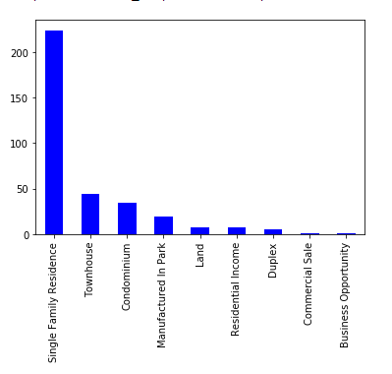
Question 1: What type of the house is most built in the Hayward town? How do cities compare?
Conclusion: Single Family Residence is the most famous house type built over in the Hayward. And the interesting fact is there a very few building with for the built type is Business Opportunity.

Slide 4
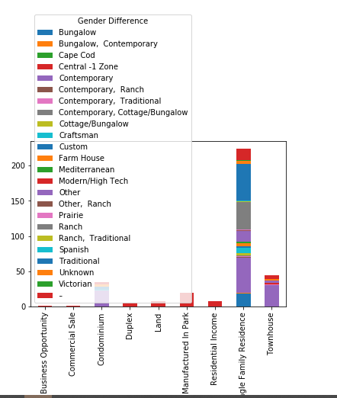
Question 2: To further explore more what style is more famous in the house type 'Single Family Residence’? Conclusion: In the House Type 'Single Family Residence ' the most famous style is 'customer', 'Prairie', and 'ranch'.

Slide 5
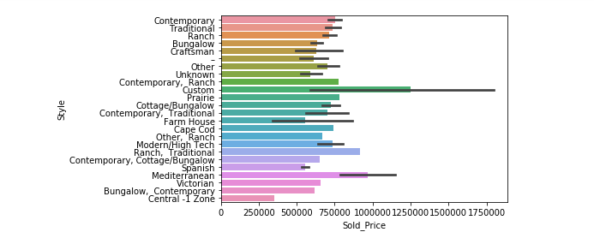
Question 3: To furthermore explore in the style of the house, what is the sold price distribution of the style? Conclusion: Customer style is the most famous style in the hayward, and the sold price is also maximum for this house.

Slide 6
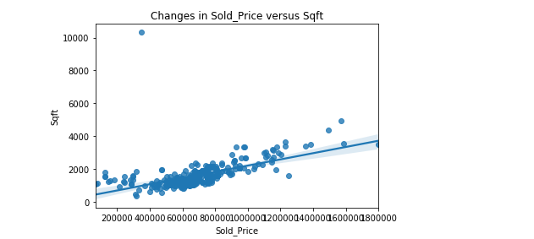
Question 4: To explore the relationship between the change in the sold_price vs sqft? Conclusion: The Sqft is positively correlated with the change on the sold price. When the sqft of a house will increase than the house sold price will also increase.

Slide 7
Thank You

